Slide 1
Remedial Education Reform Bruce Vandal, Education Commission of the States September 25, 2012

Slide 2
Riding the Storm Out
Implementation of the Common Core Standards Assessments in Spring, 2015
Estimates that only 33 – 50% of students will be assessed as college ready.
Current college remediation system is ineffective.
Without a clear strategy in states for the initial storm, the political will for the Common Core Standards may vanish.

Slide 3
Traditional Remedial Sequence
Assessment
Take single standardized exam
Placement
Cut score determines placement in one or more levels of remedial education
Enrollment
Students take 1 or more courses consecutively before enrolling in gateway courses
Completion
Success is defined as completion of remedial course

Slide 4
A Ready for College Strategy
Strategy 1
Implement an early assessment and intervention strategy for high school students

Slide 5
Early Intervention Models
Provide college placement assessments in 11th grade.
Implement an early intervention strategy or students who are below college ready
Transitional courses (Florida, California, SREB)
Deliver remedial courses at high schools through concurrent enrollment .
Utilize competency based, technologically assisted strategies.
Require 4th year math.
Create agreements guaranteeing college access for those college ready.

Slide 6
Ready for College Strategy
Strategy 2
Develop clear curricular pathways from high school to college gateway courses, particularly in mathematics

Slide 7
Curricular Pathways are Key
Art
English
Humanities
College Math
Psychology
Political Science
Statistics
Science
Technology
Engineering
Math
Algebra
Calculus

Slide 8
Creating Pathways
Develop curriculum teams of high school faculty, developmental faculty, gateway course faculty and academic program faculty.
Identify competencies required for broad programs of study.
Align common core standards, developmental curriculum, gateway course content.
Develop course offerings beginning in high school, connected to common core and aligned to curricular pathways.
Example: CAL-PASS system and Institute for Evidence Based Change.

Slide 9
Principles of Remedial Reform
Strategy 3
Incorporate high school GPA into college placement

Slide 10
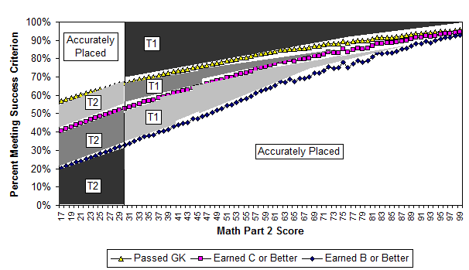
Probability of Gatekeeper Success
Overplaced
Underplaced

Slide 11
Placement Exams vs. HS GPA
Proportion of Variation Explained
Subject | Placement Test Only | HS GPA Only | Placement Test & HS GPA
B or higher in CL-Math | .12 | .10 | .17
C or higher in CL-Math | .07 | .08 | .11
Passed CL (D- or higher) Math | .04 | .06 | .07
Grades in first CL-Math | .13 | .12 | .18
B or higher in CL-English | .02 | .04 | .05
C or higher in CL-English | .01 | .04 | .05
Passed CL (D- or higher) Eng | <.01 | .03 | .04
Grades in first CL-English | .02 | .06 | .07
Scott-Clayton, 2012

Slide 12
A Ready for College Strategy
Strategy 4
Provide academic support as a co-requisite with the gateway course

Slide 13
Austin Peay’s Structured Assistance Results
 | Traditional- DSPM 0800 | Traditional – DSPM 0850 | Traditional College Ready | Redesign
Math Thought and Practice | 11.6% | 43.5% | 85% | 76.3%
Fundamentals of Statistics | 7.5% | 28.8% | 56.2% | 61.2%

Slide 14
Ready for College Strategy
Strategy 5
Provide students with significant learning challenges routes into certificates or accelerated programs of study

Slide 15
Washington I-BEST Model
Integrated Learning Outcomes
Compile Resources
Create Integrated Learning Outcomes
Match Available Standards to Integrated Learning Outcomes
Assess, Review and Revise Integrated Learning Outcomes
Integrated Teaching
Both instructors work as a collaborative team to design and deliver the program.
They are both present in the classroom
The adult basic education instructor ensures that basic skills are within the context of the workforce education content and gauge student progress.
The workforce education instructor focuses on the delivery of the workforce content.

Slide 16
Washington’s I-BEST Results
I-BEST students were more likely to:
continue into credit-bearing courses
earn credits toward a credential
earn a certificate
improve their basic skills.
Probability of credential 50% greater for I-BEST Students

Slide 17
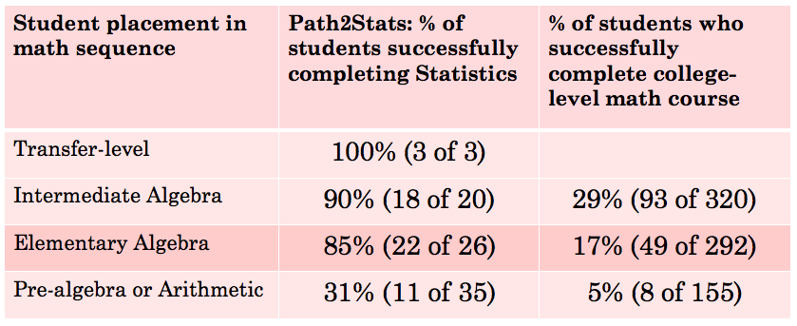
Los Medanos Path2Stats Course

Slide 18
Accelerated Remedial Sequence
Assessment
Use of multiple tools to include HS curriculum, HS GPA and diagnostic academic assessment
Placement
Maps student progress through a program of study
Enrollment
Co-Enrollment in Remedial and College-Level Course
Success is defined as completion of gateway course
Completion
Single semester remedial option
Enrollment in a program of study
Earning a credential
Provide HS students early intervention options
Contextualized instruction in program of study
Assess no later than 11th grade

Slide 19
For More Information
Bruce Vandal
bvandal@ecs.org
Twitter: @BruceatECS
http://GettingPastGo.org

